Slide 1
Prepositions of time

Slide 2


Slide 3
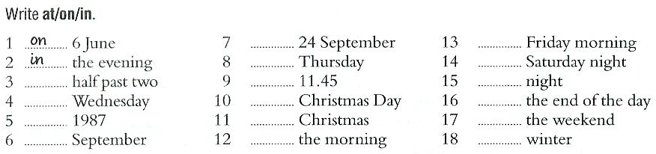
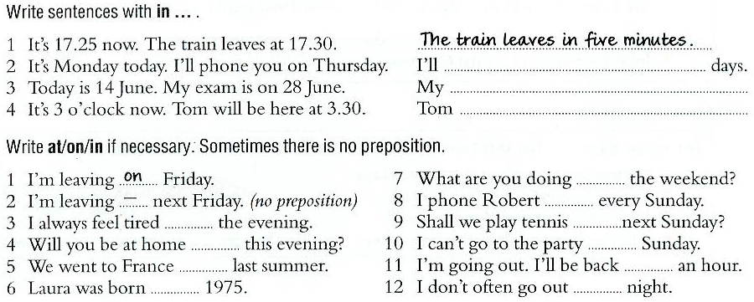

Slide 4
Modal verbs. Can and Could.
I can do something=I know how to do it or it is possible for me to do it:
  I can play the piano.
  Sarah can speak Italian but she can’t speak Spanish.
  “Can you swim?”
For the past (yesterday / last week etc.), we use could / couldn’t:
  When I was young, I could run very fast.
  I was tired last night but I couldn’t sleep.

Slide 5
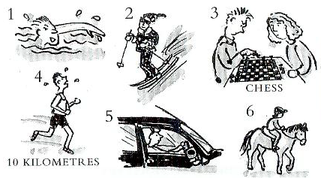
Make questions with “can”.

Slide 6
Write the sentences with can / can’t
Correct the following sentences.
Can you coming to the party next week?
My brother can’t plays basketball.
I no can swim.
Alice can to go running after work.
Can Lisa visits her cousins?

