Slide 1
There is / there are
Describing controls
Numbers 20 - 100

Slide 2

NUMBERS 20 - 100

Slide 3


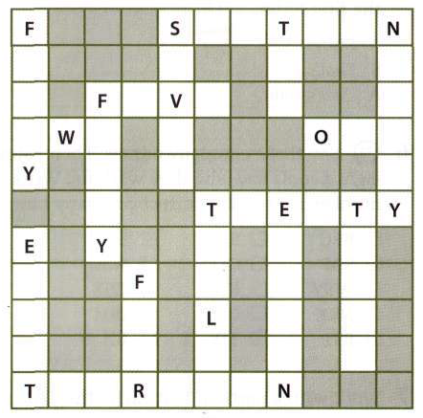

Slide 4
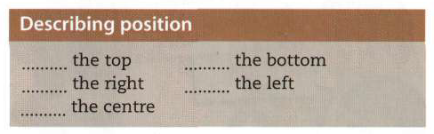

Slide 5
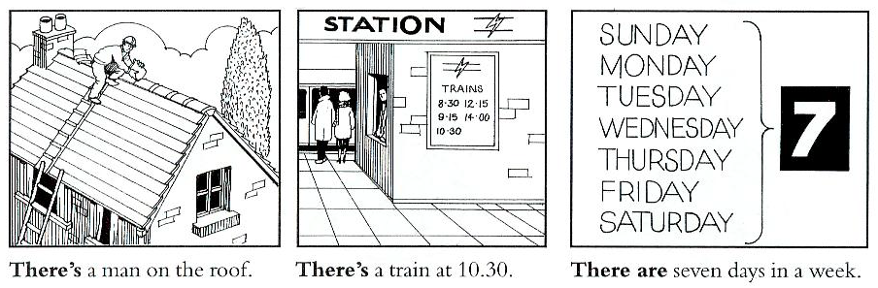
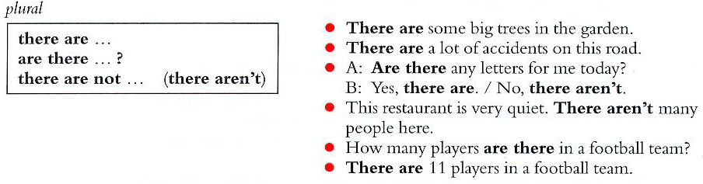
THERE IS / THERE ARE

Slide 7
