Slide 1
Contrasting ideas

Slide 3
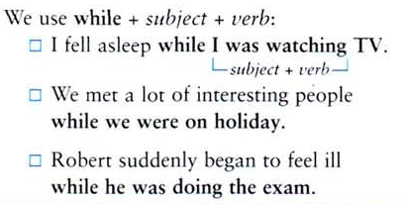

Slide 4
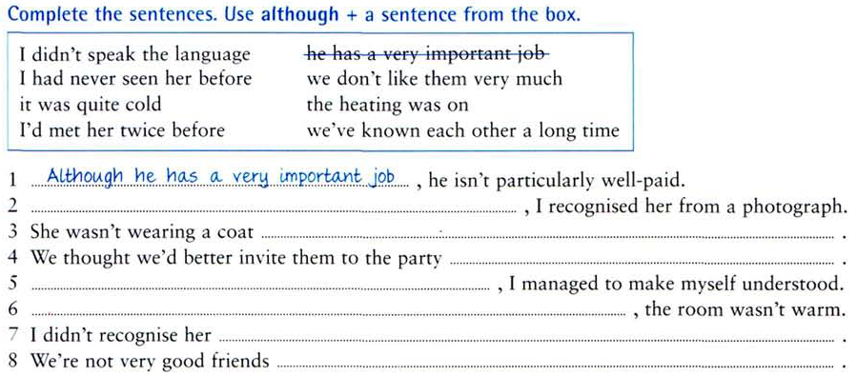

Slide 5
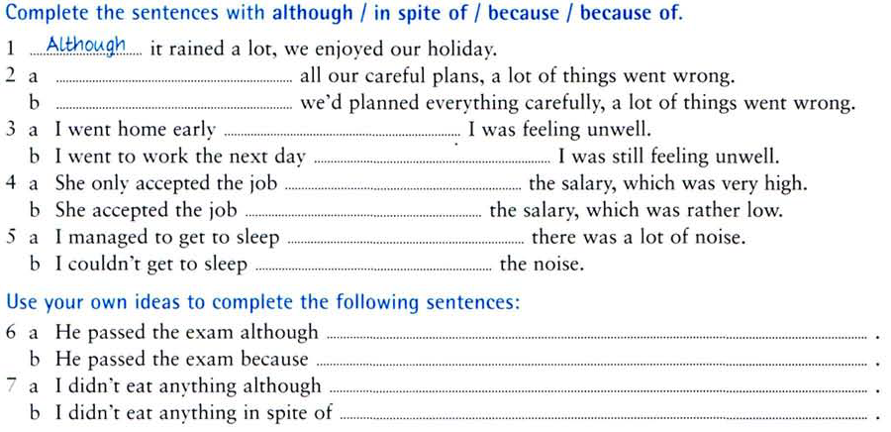

Slide 6
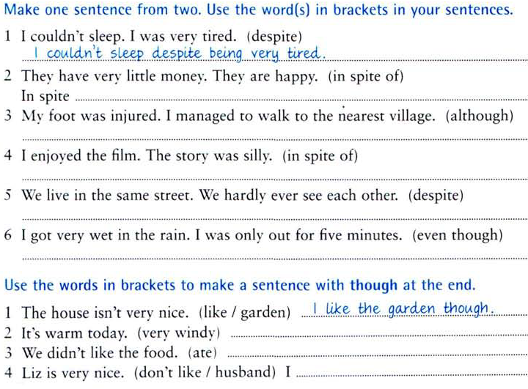

Slide 7
But / However
But is more informal than however. You can use however at the beginning of a sentence, but you can’t use but at the beginning of a sentence (in written English).
I tried to lift the box, but it was too heavy for me.
I tried to lift the box. However, it was too heavy for me.
Although / Even though
These linking words are the same, and they are both followed by a subject + verb.
Although I exercise every day, I can’t seem to lose any weight.
She still loves him, even though he treated her very badly.
Despite / In spite of
These linking words are the same, and they are followed by a noun or a gerund (-ing form of the verb, which can function as a noun).
Our plane arrived on time in spite of the delay during takeoff.
We won the game despite having two fewer players.
Despite the fact that / in spite of the fact that
These phrases are followed by a subject + verb.
Our plane arrived on time in spite of the fact that it left 30 minutes late.
We won the game despite the fact that we had two fewer players.
While / Whereas / Unlike
These linking words are used to make contrasts. While and whereas are usually used between two complete phrases. Unlike is typically used with only a subject.
I like tennis, while my brother prefers bowling.
This cell phone plan costs $0.05 per minute, whereas that one gives you up to 800 minutes per month for a fixed price.
His boss allows him to work from home, unlike mine.
She’s very friendly, unlike her sister.

Slide 8
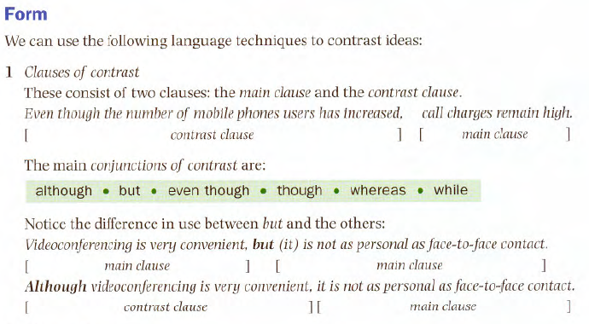
Sample sentences
Although email is a very convenient form of personal communication, most people have never sent one. But the number of users is increasing very quickly. Despite improvements in telecoms networks, connection speeds are often very slow; however ADSL promises faster connections.

Slide 9
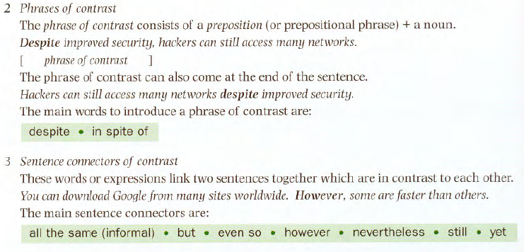

Slide 10
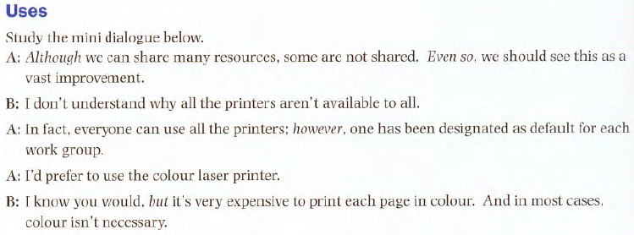

Slide 11
