Slide 1
(not) as … as

Slide 2
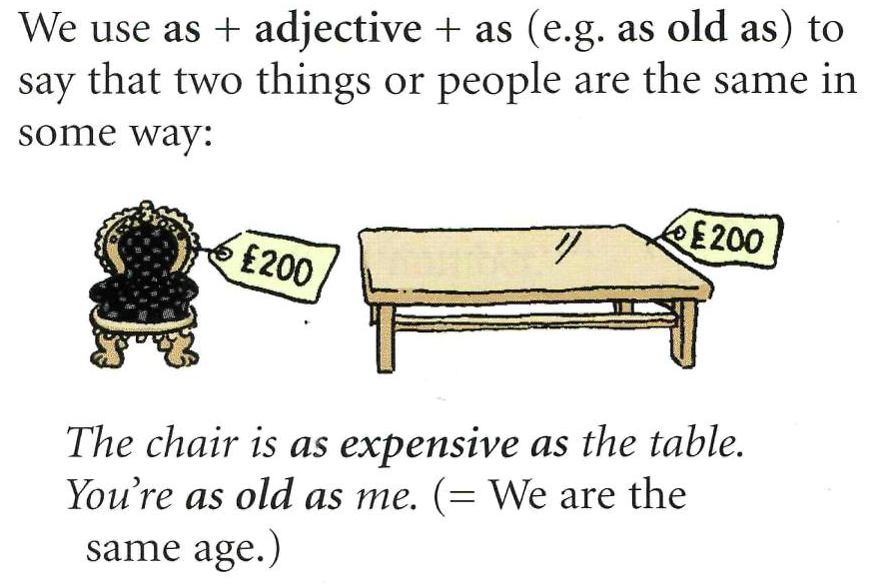
Comparison: (not) as…as

Slide 3
We say as me / as him / as her / as us / as them:
She’s as strong as him. (Not …as he!)
I’m as fast as them. (Not … as they!)
(not) as many + plural noun + as:
Jane has got as many friends as Mary.
I don’t have as many books as you.
(not) as much as + uncountable noun + as:
Helen earns as much money as Colin.
Jack doesn’t do as much work as me.

Slide 6
