Slide 1
Passive Voice

Slide 2
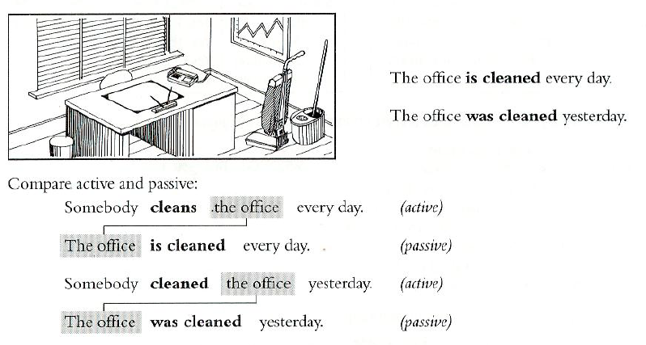
it‘s used when the focus is on the action
it‘s not important who or what is performing the action, but the action itself is important
The streets are cleaned.
Books are written.
House is built.

Slide 4
rewriting active sentences in passive:
object subject
(active) (passive)
A: Somebody cleans this room every day.
OBJECT
P: This room is cleaned every day.
SUBJECT

Slide 5
the verb BE has to be in the same tense as in active sentence
A: Someone stole my sister’s bike yesterday.
P: My sister’s bike was stolen yesterday.
stole – past simple => BE = was/were
to show who did the action, we use BY
This house was built by my grandfather.

Slide 6
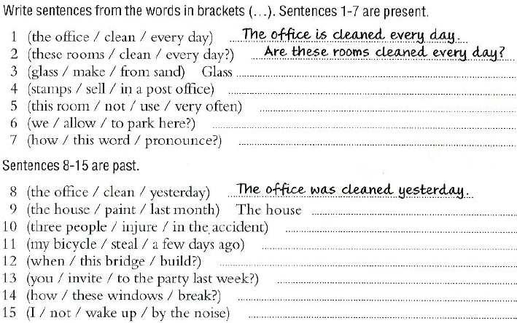

Slide 7
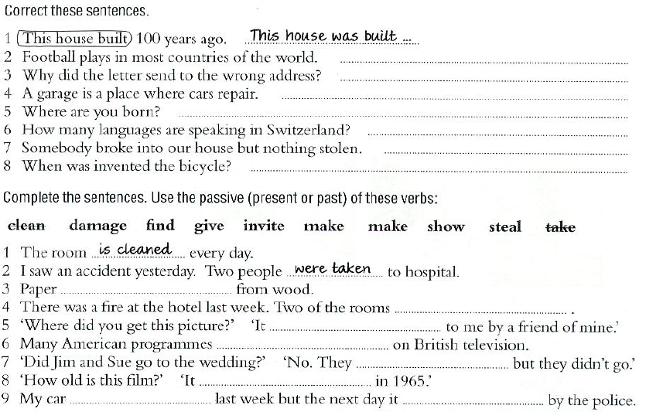

Slide 8
Passive Voice – present simple
form: am/is/are (not)+ past participle
The grandma is always invited.
Many accidents are caused by dangerous driving.
I’m not invited to parties.
How many people are injured in car accidents every year?

Slide 9
Passive Voice – past simple
form: was/were (not) + past participle
This room was cleaned.
During the night we were woken up by a loud explosion.
When was the castle built?
This house wasn’t damaged in the storm.

